Slide 1


Salami Lukman Bayonle
12th December, 2022

Slide 2

Outline
Executive Summary
Introduction
Methodology
Results
Conclusion
Appendix

Slide 3
Executive Summary
Summary of methodologies
Jupyter Notebooks running on python 3 was used along with IBM Watson studio and DB console.
Data Collection through API
Data Collection with Web Scraping
Data Wrangling
Exploratory Data Analysis with SQL
Exploratory Data Analysis with Data Visualization
Interactive Visual Analytics with Folium
Machine Learning Prediction
Summary of all results
Exploratory Data Analysis result
Interactive analytics in screenshots
Predictive Analytics result

Slide 4
Introduction
Project background and context
Falcon 9 is a reusable, two-stage rocket designed and manufactured by SpaceX for the reliable and safe transport of people and payloads into Earth orbit and beyond. Falcon 9 is the world’s first orbital class reusable rocket. Reusability allows SpaceX to refly the most expensive parts of the rocket, which in turn drives down the cost of space access. Space X can reuse the first stage. Therefore, if we can determine if the first stage will land, we can determine the cost of a launch. This information can be used if an alternate company wants to bid against space X for a rocket launch. This goal of the project is to create a machine learning pipeline to predict if the first stage will land successfully.
Problems you want to find answers
What factors determine if the rocket will land successfully?
The interaction amongst various features that determine the success rate of a successful landing.
What operating conditions needs to be in place to ensure a successful landing program.

Slide 5

Section 1

Slide 6
Methodology
Executive Summary
Data collection methodology:
Data was collected using SpaceX API and web scraping from Wikipedia.
Data wrangling
One-hot encoding was applied to categorical features
Standard Scaling was applied to the features.
Exploratory data analysis (EDA) using visualization and SQL
Interactive visual analytics using Folium and Plotly Dash
Perform predictive analysis using classification models
Data was split to train-test, Logistic Regression, KNN, SVC and decision tree were use for classification
GridSearch was used to select the best parameters for the models

Slide 7
Data Collection
Describe how data sets were collected.
Data collection was done using get request to the SpaceX API.
Next, we decoded the response content as a Json using .json() function call and turn it into a pandas dataframe using .json_normalize().
We then cleaned the data, checked for missing values and fill in missing values where necessary.
In addition, we performed web scraping from Wikipedia for Falcon 9 launch records with BeautifulSoup.
The objective was to extract the launch records as HTML table, parse the table and convert it to a pandas dataframe for future analysis.

Slide 8
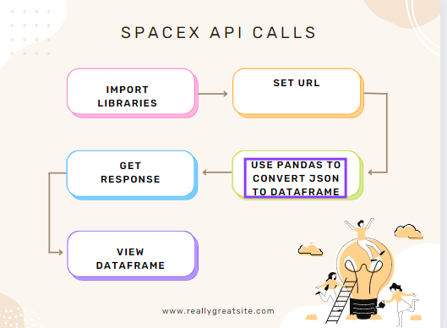
Data Collection – SpaceX API
We used the get request to the SpaceX API to collect data, clean the requested data and did some basic data wrangling and formatting.
https://github.com/bayonlelukmansalami/spacex/blob/main/jupyter-labs-spacex-data-collection-api.ipynb

Slide 9
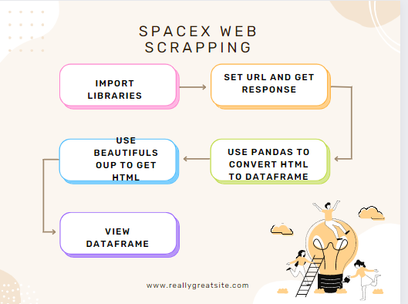
Data Collection - Scraping
We applied web scrapping to webscrap Falcon 9 launch records with BeautifulSoup
We parsed the table and converted it into a pandas dataframe.
https://github.com/bayonlelukmansalami/spacex/blob/main/jupyter-labs-webscraping1.ipynb

Slide 10
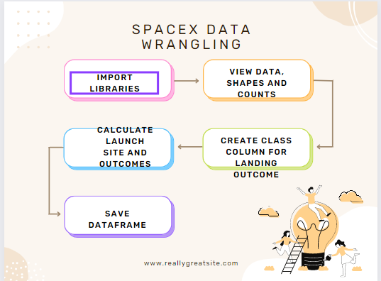
Data Wrangling
We performed exploratory data analysis and determined the training labels.
We calculated the number of launches at each site, and the number and occurrence of each orbits
We created Class column from landing outcome column and exported the results to csv
https://github.com/bayonlelukmansalami/spacex/blob/main/labs-jupyter-spacex-Data%20wrangling.ipynb

Slide 11
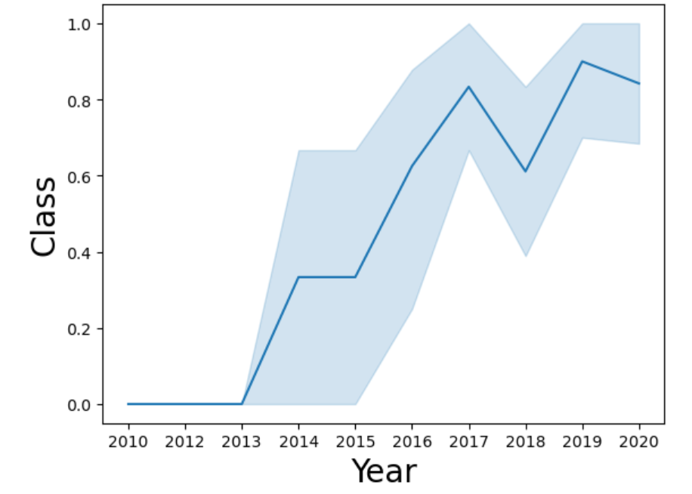
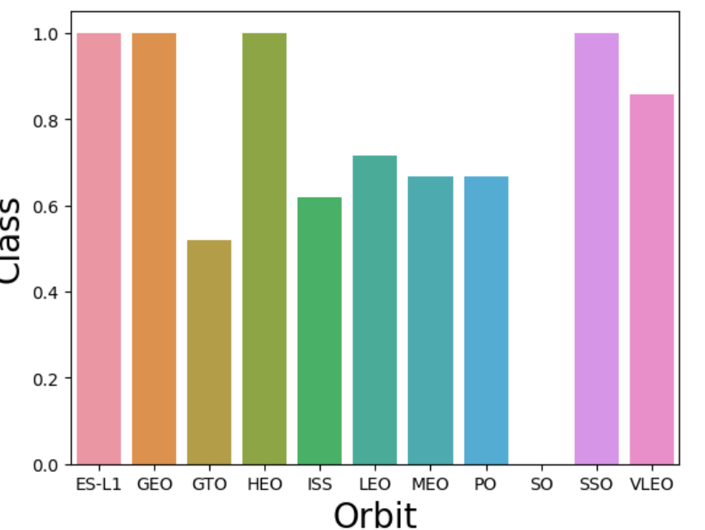
EDA with Data Visualization
We explored the data by visualizing the relationship between flight number and launch Site, payload and launch site, success rate of each orbit type, flight number and orbit type, the launch success yearly
https://github.com/bayonlelukmansalami/spacex/blob/main/jupyter-labs-eda-dataviz.ipynb

Slide 12
EDA with SQL
We loaded the SpaceX dataset into a PostgreSQL database without leaving the jupyter notebook.
We applied EDA with SQL to get insight from the data. We wrote queries to find out for instance:
The names of unique launch sites in the space mission.
The total payload mass carried by boosters launched by NASA (CRS)
The average payload mass carried by booster version F9 v1.1
The total number of successful and failure mission outcomes
The failed landing outcomes in drone ship, their booster version and launch site names.
The link to the notebook is https://github.com/bayonlelukmansalami/spacex/blob/main/jupyter-labs-eda-sql-coursera_sqllite.ipynb

Slide 13
Build an Interactive Map with Folium
We marked all launch sites, and added map objects such as markers, circles, lines to mark the success or failure of launches for each site on the folium map.
We assigned the feature launch outcomes (failure or success) to class 0 and 1.i.e., 0 for failure, and 1 for success.
Using the color-labeled marker clusters, we identified which launch sites have relatively high success rate.
We calculated the distances between a launch site to its proximities. We answered some question for instance:
Are launch sites near railways, highways and coastlines.
Do launch sites keep certain distance away from cities.
https://github.com/bayonlelukmansalami/spacex/blob/main/lab_jupyter_launch_site_location.ipynb

Slide 14
Build a Dashboard with Plotly Dash
We built an interactive dashboard with Plotly dash
We plotted pie charts showing the total launches by a certain sites
We plotted scatter graph showing the relationship with Outcome and Payload Mass (Kg) for the different booster version.
https://github.com/bayonlelukmansalami/spacex/blob/main/spacex_dash_app2.py

Slide 15
Predictive Analysis (Classification)
We loaded the data using numpy and pandas, transformed the data, split our data into training and testing.
We built different machine learning models and tune different hyperparameters using GridSearchCV.
We used accuracy as the metric for our model, improved the model using feature engineering and algorithm tuning.
We found the best performing classification model.
https://github.com/bayonlelukmansalami/spacex/blob/main/SpaceX_Machine%20Learning%20Prediction_Part_5.ipynb

Slide 16
Results
Exploratory data analysis results
Interactive analytics demo in screenshots
Predictive analysis results

Slide 17

Section 2

Slide 18
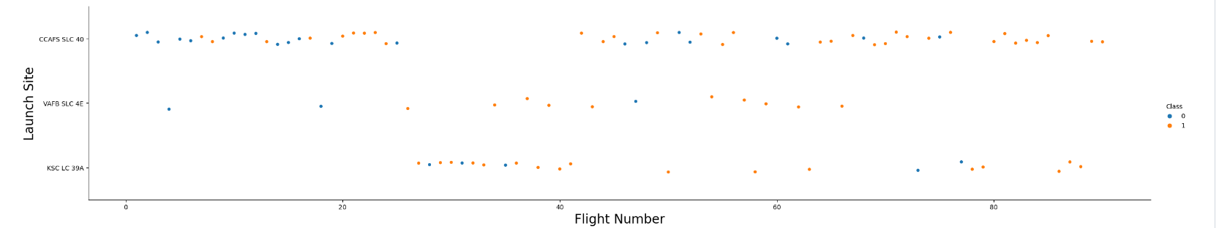
Flight Number vs. Launch Site
Scatter plot of Flight Number vs. Launch Site
From the plot, we found that the larger the flight amount at a launch site, the greater the success rate at a launch site.

Slide 19
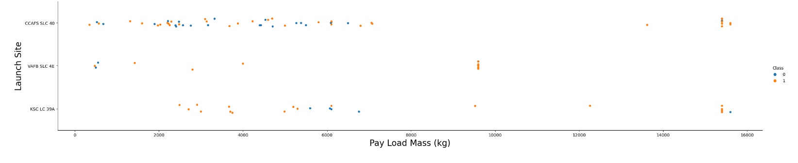
Payload vs. Launch Site
Scatter plot of Payload vs. Launch Site
VAFB-SLC launchsite has no rockets launched for heavypayload mass(greater than 10000) while the higher the payload mass for others the higher the success rate.

Slide 20
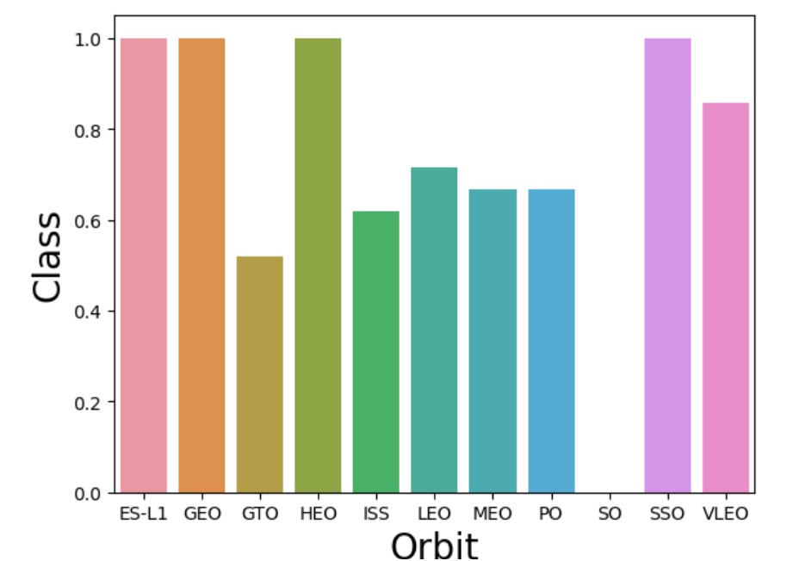
Success Rate vs. Orbit Type
Bar chart for the success rate of each orbit type
From the plot, we can see that ES-L1, GEO, HEO, and SSO had the most success rate.

Slide 21
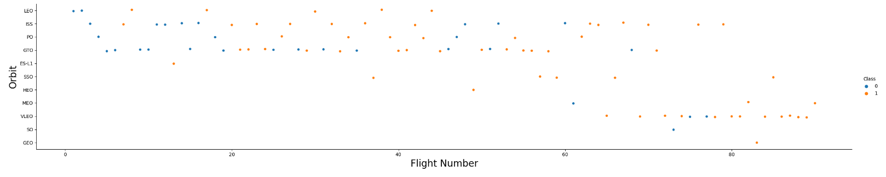
Flight Number vs. Orbit Type
Scatter plot of Flight number vs. Orbit type
You should see that in the LEO orbit the Success appears related to the number of flights; on the other hand, there seems to be no relationship between flight number when in GTO orbit.

Slide 22
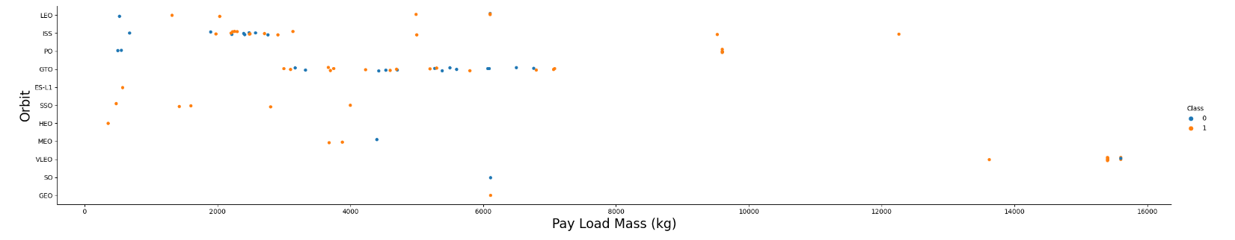
Payload vs. Orbit Type
scatter plot of payload vs. orbit type
With heavy payloads the successful landing or positive landing rate are more for Polar,LEO and ISS.
However for GTO we cannot distinguish this well as both positive landing rate and negative landing(unsuccessful mission) are both there here

Slide 23

Launch Success Yearly Trend
Line chart of yearly average success rate
We can observe that the sucess rate since 2013 kept increasing till 2020

Slide 24
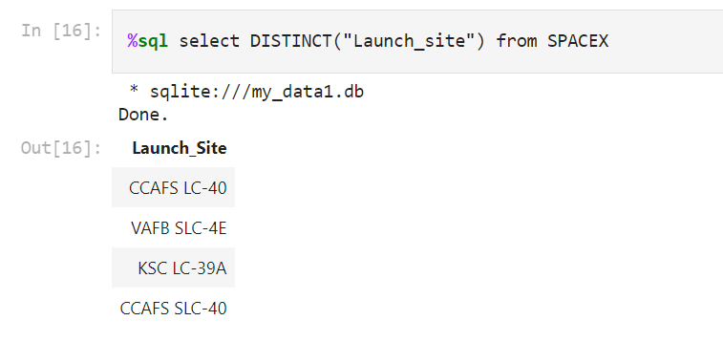
All Launch Site Names
We used the key word DISTINCT on EDA sqlite on python to show only unique launch sites from the SpaceX data.

Slide 25
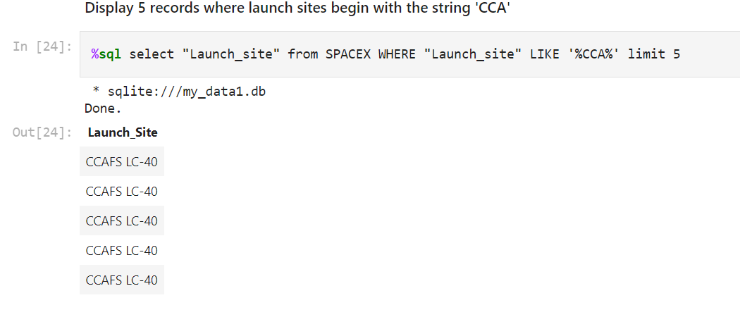
Launch Site Names Begin with 'CCA'
5 records where launch sites begin with `CCA`
Using the SQL syntax Launch_site LIKE %CCA%, we get launch sites which begins with CCA

Slide 26
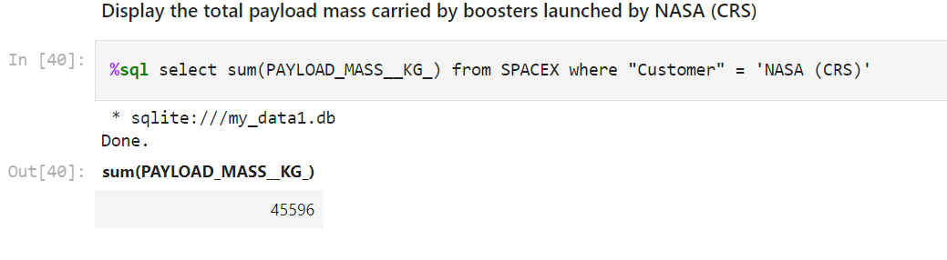
Total Payload Mass
We calculated the total payload carried by boosters from NASA as 45596kg using the sum syntax on the payload mass column.

Slide 27
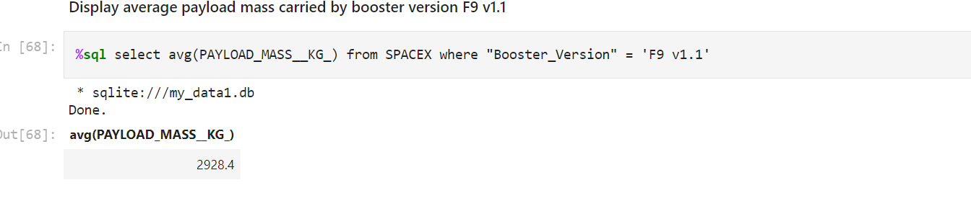
Average Payload Mass by F9 v1.1
We calculated the average payload mass carried by booster version F9 v1.1 as 2928.4kg

Slide 28
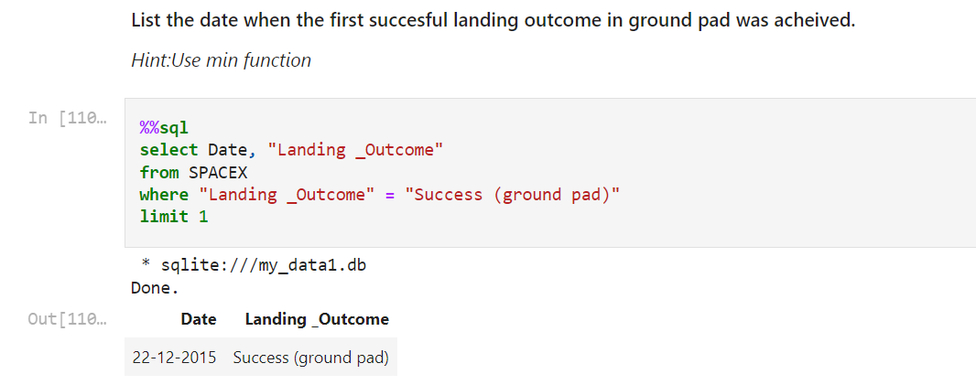
First Successful Ground Landing Date
We observed that the dates of the first successful landing outcome on ground pad was 22nd December 2015 using the where clause on landing outcome equals to success on ground pad

Slide 29
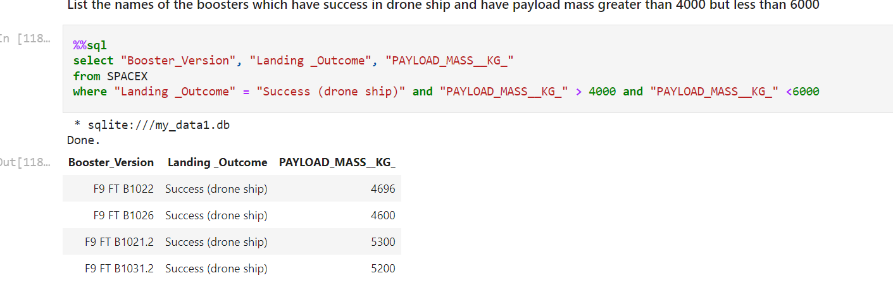
Successful Drone Ship Landing with Payload between 4000 and 6000
We used the WHERE clause to filter for boosters which have successfully landed on drone ship and applied the AND condition to determine successful landing with payload mass greater than 4000 but less than 6000

Slide 30
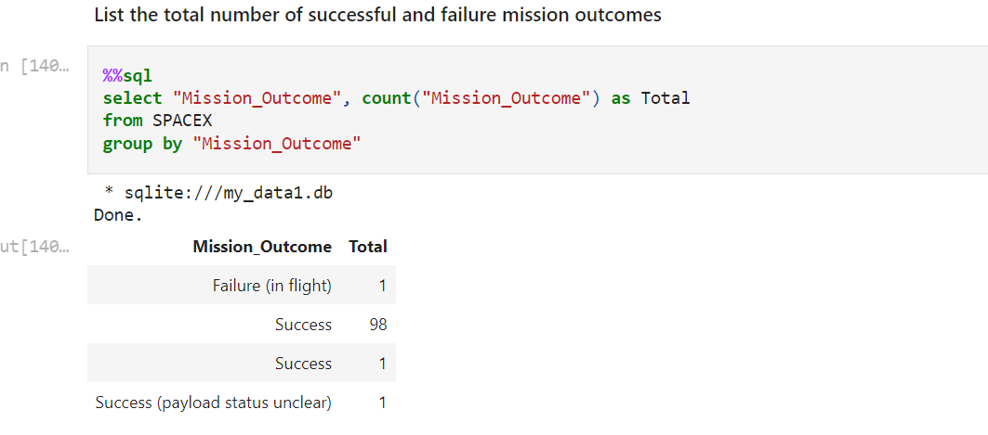
Total Number of Successful and Failure Mission Outcomes
We use the group by Mission Outcome to get the total number of successful and failure mission outcomes

Slide 31
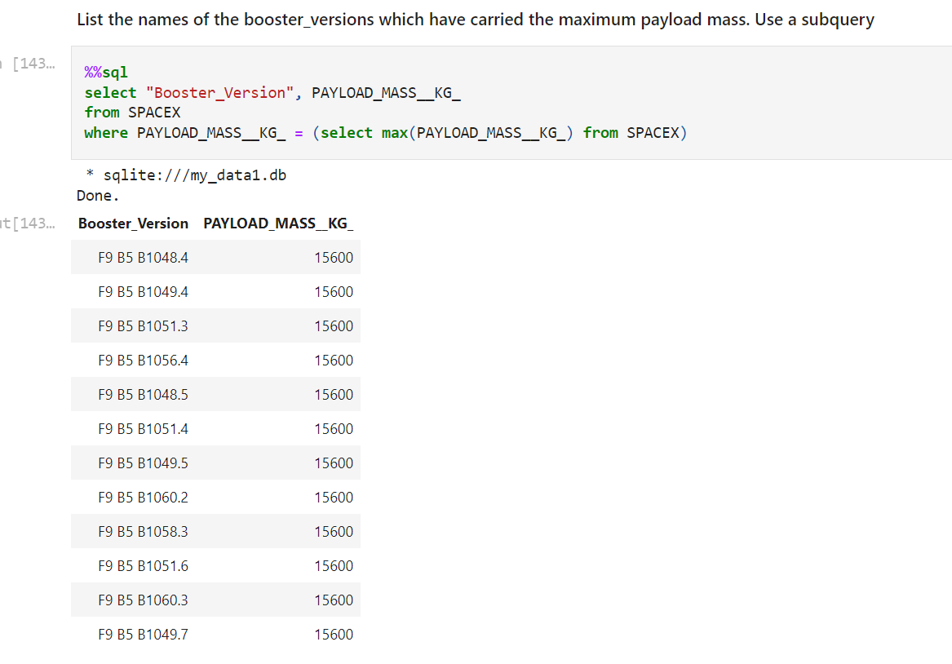
Boosters Carried Maximum Payload
We determined the booster that have carried the maximum payload using a WHERE clause on the payload mass column and a MAX() function in a subquery also on the payload mass column.

Slide 32
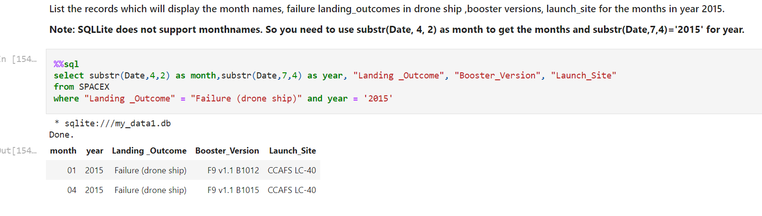
2015 Launch Records
We extracted the month and year, then used a combinations of the WHERE clause and AND clause conditions to filter for failed landing outcomes in drone ship, their booster versions, and launch site names for year 2015

Slide 33

Rank Landing Outcomes Between 2010-06-04 and 2017-03-20
Rank the count of landing outcomes (such as Failure (drone ship) or Success (ground pad)) between the date 2010-06-04 and 2017-03-20, in descending order

Slide 34

Section 3

Slide 35
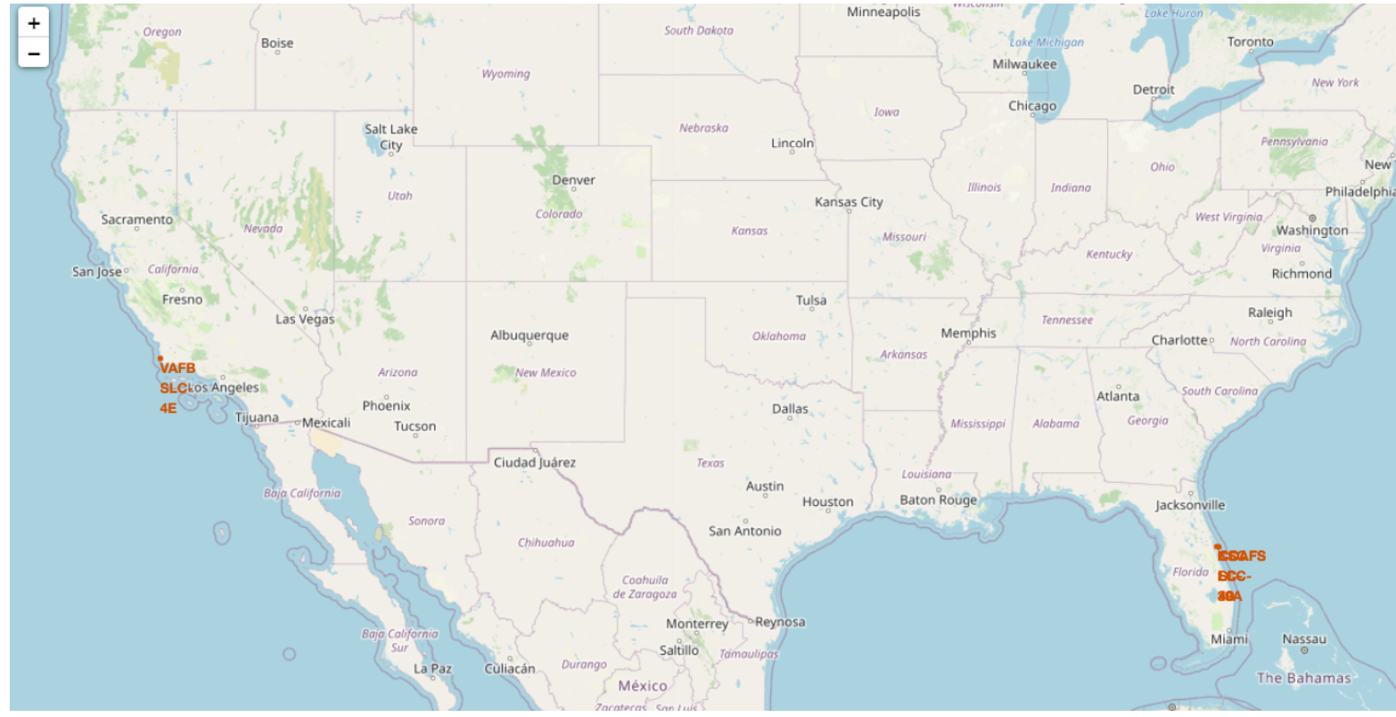
SPACEX LAUNCH SITES
SpaceX launch sites are located along the USA coastlines.

Slide 36
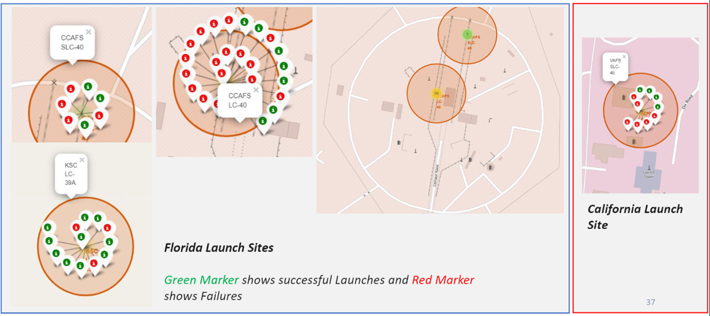
Markers showing launch sites with color labels
Replace <Folium map screenshot 2> title with an appropriate title
Explore the folium map and make a proper screenshot to show the color-labeled launch outcomes on the map
Explain the important elements and findings on the screenshot

Slide 37

Launch Site distance to landmarks

Slide 38

Section 4

Slide 39

SPACEX LAUNCH RECORDS DASHBOARD

Slide 40

Pie chart showing the Launch site with the highest launch success ratio

Slide 41

Scatter plot of Payload vs Launch Outcome for all sites, with different payload selected in the range slider

Slide 42

Section 5

Slide 43
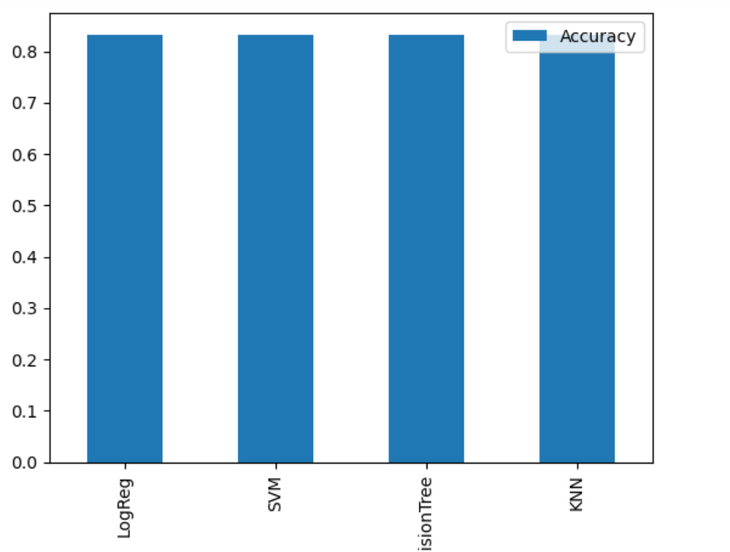
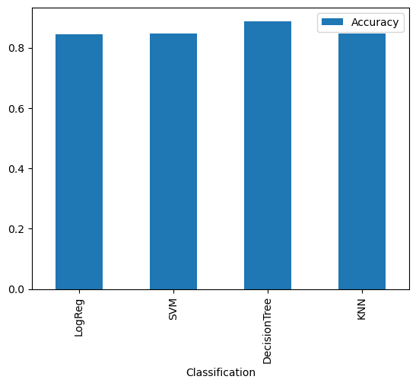
Classification Accuracy
Decision Tree performs better on training set.
They all have the same accuracy on the validation dataset.

Slide 44
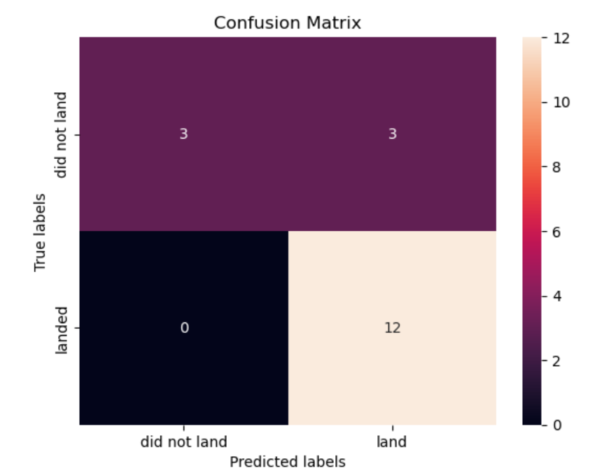
Confusion Matrix
The confusion matrix for the decision tree classifier shows that the classifier can classify successful landing(True Positives) between the different classes. The major problem is the false positives .i.e., unsuccessful landing marked as successful landing by the classifier.

Slide 45
Conclusions
We can conclude that:
The higher the number of flights at a launch site, the greater the success rate at a launch site.
Launch success rate started to increase in 2013.
Orbits ES-L1, GEO, HEO, SSO, VLEO had the most success rate.
KSC LC-39A had the most successful launches of any sites.
The Decision tree classifier is the best machine learning algorithm for this task.

Slide 46
Appendix
dataset_part_1,2,3
mySpaceX.csv
lab_jupyter_launch_site_location
labs-jupyter-spacex-Data wrangling
jupyter-labs-eda-dataviz
jupyter-labs-eda-sql-coursera_sqllite
jupyter-labs-spacex-data-collection-api
jupyter-labs-spacex-data-collection-api
spacex_dash_app2

Slide 47


